Slide 1

Python Programming Overview

Slide 2
Introduction to Python
Python is a versatile, high-level programming language. Created by Guido van Rossum in 1991. Focuses on code readability and simplicity.

Slide 3
Key Features
Easy-to-learn syntax.
Extensive standard libraries.
Supports multiple programming paradigms: procedural, object-oriented, functional.

Slide 4
Why Learn Python?
Popular: Widely used in web development, data science, automation, and more.
Community Support: A large, active community with vast resources.
Versatile: Python can be used for scripting, web development, data analysis, and machine learning.

Slide 5
Agenda
Decision-Making Statements
Data Types and Operators
List
String
Loop
Functions
Classes
Encapsulation
Dictionary
Numpy
Pandas
List Comprehension
Lambda
Regular Expressions
Exceptions
Custom Exceptions

Slide 6
Agenda
Set
Partial
Closures
Map, Filter, Reduce
Date and Time
File Handling
Lock & Concurrency
Memory Management
Semaphores

Slide 7
Decision-Making Statements
Decision-making statements allow Python programs to make choices.
Commonly used statements:
If
if...else
Elif
nested if

Slide 8
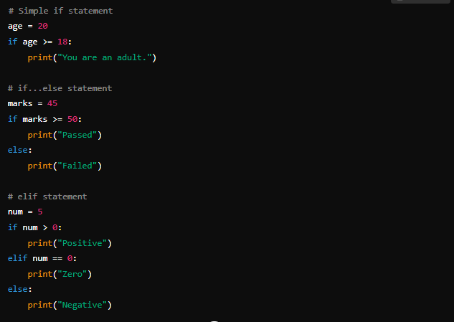
Decision-Making Statements

Slide 9
Data Types and Operators
Python has various data types like:
Numeric (int, float, complex)
String
List, Tuple
Dictionary
Set
Operators include:
Arithmetic (+, -, *, /)
Comparison (==, >, <)
Logical (and, or, not)

Slide 10
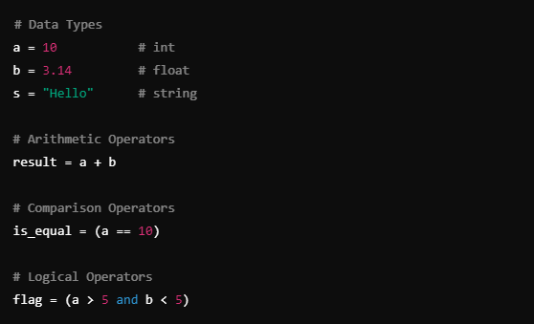
Data Types and Operators

Slide 11
List
A list is a collection of ordered, mutable, and indexed elements.
Allows duplicates.
Defined using square brackets [ ].

Slide 12
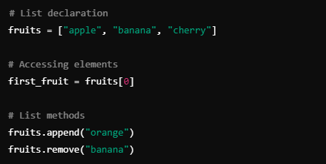
List

Slide 13
String
Strings are sequences of characters enclosed in quotes.
Python supports both single and double quotes.
Strings are immutable.

Slide 14
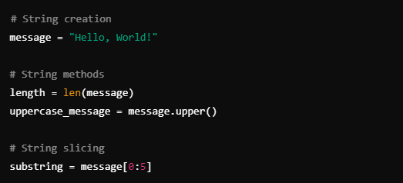
String

Slide 15
Loop
Loops are used for iteration.
for loop: Iterates over a sequence.
while loop: Repeats as long as a condition is true.

Slide 16
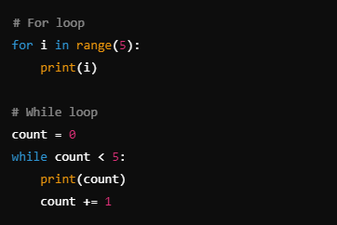
Loop

Slide 17
Functions
Functions are reusable blocks of code that perform a specific task.
Defined using the def keyword.

Slide 18
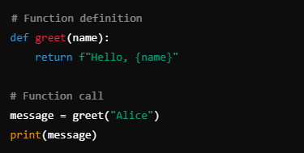
Functions

Slide 19
Classes
Classes are blueprints for creating objects.
Defined using the class keyword.
Encapsulates data and methods.

Slide 20
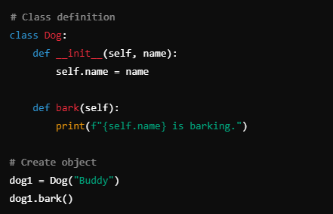
Classes

Slide 21
Encapsulation
Encapsulation is the bundling of data with methods that operate on the data.
Access is restricted via private attributes.

Slide 22
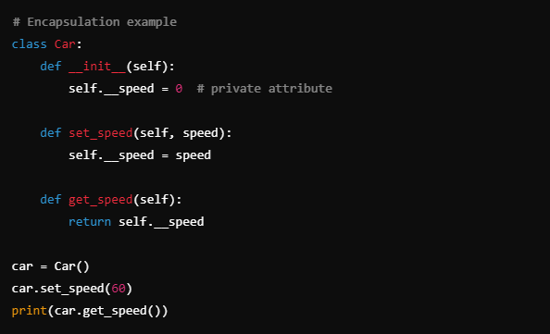
Encapsulation

Slide 23
Dictionary
A dictionary stores key-value pairs.
Keys are unique, and values can be accessed using keys.

Slide 24
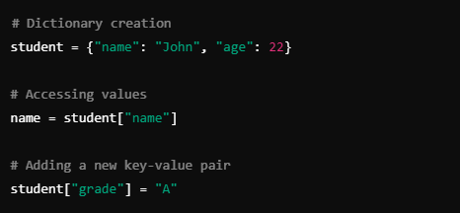
Dictionary

Slide 25
Numpy
Numpy is a library for numerical computing.
Provides support for arrays and mathematical functions.

Slide 26
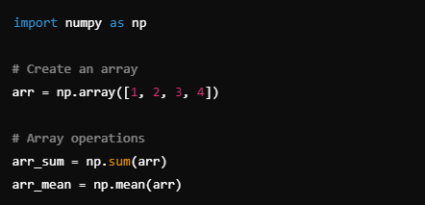
Numpy

Slide 27
Pandas
Pandas is a data manipulation and analysis library.
It provides DataFrames to work with structured data.

Slide 28
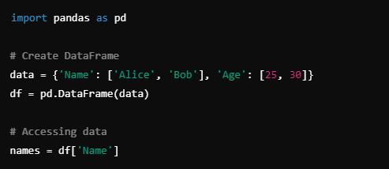
Pandas

Slide 29

List Comprehension
Efficient: A concise way to create lists.
Readable: Makes code simpler and more intuitive.
Versatile: Can include conditions to filter data during list creation.

Slide 30

Lambda
Anonymous Functions: Functions without a name.
Compact: Defined in a single line.
Inline Use: Often used in conjunction with map(), filter(), and reduce().

Slide 31
Regular Expressions
Pattern Matching: Search for patterns in strings.
Flexible: Allows powerful string manipulations.
Useful in Validation: Frequently used in input validation.

Slide 32
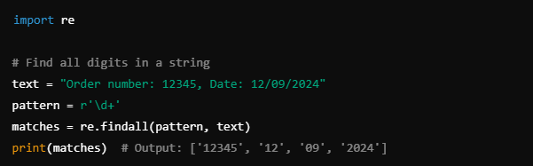
Regular Expressions

Slide 33
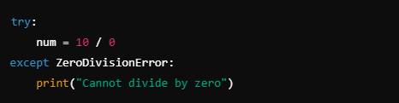
Exceptions
Error Handling: Manages runtime errors.
Avoid Crashes: Allows programs to handle unexpected situations.
Use try/except: Prevents complete application breakdown.

Slide 34
Custom Exceptions
User-Defined Errors: Create specific exceptions for custom conditions.
Clarity: Allows more precise error reporting.
Use Cases: When built-in exceptions don’t fit the situation.

Slide 35
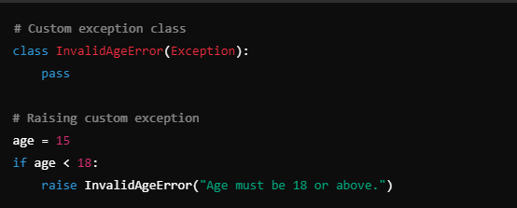
Custom Exceptions

Slide 36
Set
Unique Items: Contains only unique elements.
Unordered: No guaranteed order.
Efficient Operations: Supports operations like union, intersection, and difference.

Slide 37
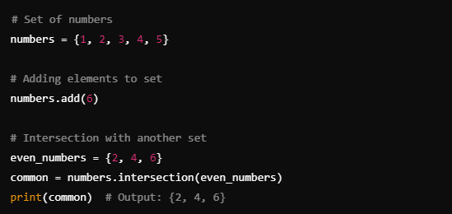
Set

Slide 38
Partial
Function Modification: Fix some arguments of a function.
Convenience: Create simpler versions of existing functions.
Functional Programming: Useful in functional paradigms.

Slide 39
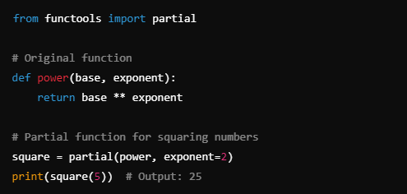
Partial

Slide 40
Closures
Inner Functions: Functions defined within other functions.
Access Outer Variables: Inner function has access to variables of the enclosing function.
State Preservation: Remembers the environment in which it was created.

Slide 41
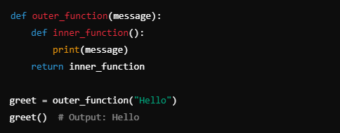
Closures

Slide 42
Map, Filter, Reduce
map( ): Applies a function to each item in an iterable.
filter( ): Filters elements based on a condition.
reduce( ): Reduces an iterable to a single value.

Slide 43
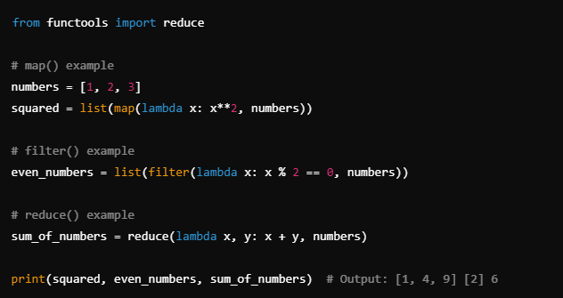
Map, Filter, Reduce

Slide 44
Date and Time
Current Time: Retrieve current date and time.
Formatted Dates: Easily manipulate and format date/time.
Time Arithmetic: Supports date arithmetic like addition or difference.

Slide 45
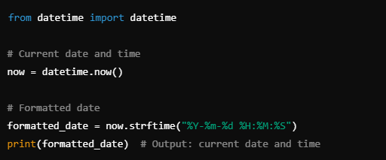
Date and Time

Slide 46
File Handling
Read/Write Operations: Easily read and write to files.
File Modes: r, w, a, and b for text and binary modes.
Context Management: Automatically closes the file using with.

Slide 47
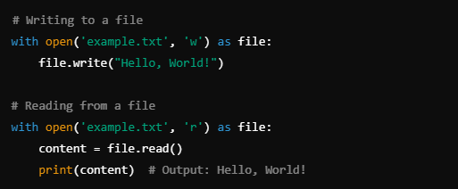
File Handling

Slide 48
Lock & Concurrency
Thread Synchronization: Locks prevent race conditions.
Shared Resources: Ensures only one thread accesses a resource at a time.
Concurrency: Helps manage parallel threads safely.

Slide 49
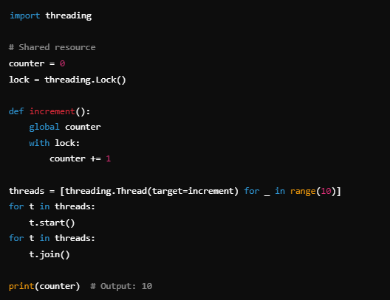
Lock & Concurrency

Slide 50
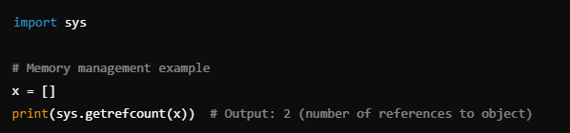
Memory Management
Automatic Garbage Collection: Python automatically manages memory.
Reference Counting: Objects are deallocated when no longer referenced.
Cyclic Garbage Collector: Detects and cleans cyclic references.

Slide 51
Semaphores
Resource Control: Used to manage access to limited resources.
Limits Concurrent Access: Ensures only a set number of threads can access a resource.
Thread Synchronization: Useful in thread-based programming.

Slide 52
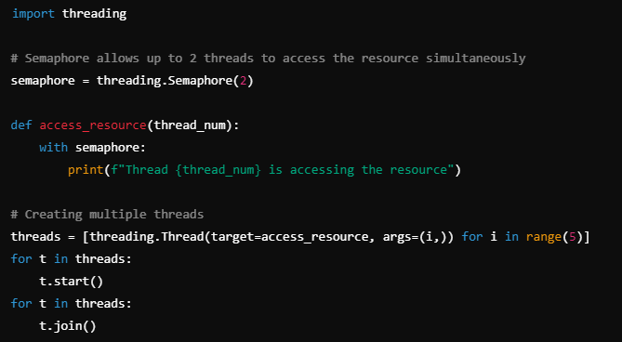
Semaphores

